Slide 1
Unprecedented Times, Unprecedented Responses: How California’s Schools Are Using Federal COVID-19 Relief Funds
July 12, 2022

Slide 2
Housekeeping
At the end of the presentation, we will have a Question-and-Answer segment where we will try our best to answer your questions.
Please, use the Q & A feature of Zoom to type your questions. This is located on ribbon below the speaker.
Your questions will be answered either in the Q & A panel or live by our presenters.
All attendees will receive a link to the video of this webinar as well as the slide deck.

Slide 3
Today’s Presenters
Mary Briggs – Senior Director, Research and Education Policy Development, California School Boards Association
Jeremy Anderson – Education Policy Analyst, Research and Education Policy Development, California School Boards Association
Susan Markarian – President-elect, CSBA and Board of Trustees, Pacific Union Elementary School District
Zandra Jo Galván – Superintendent, Greenfield Elementary School District
Troy Flint – Chief Information Officer, California School Boards Association

Slide 4
A CSBA Analysis of Federal COVID-19 Relief Spending in California Public Schools

Slide 5
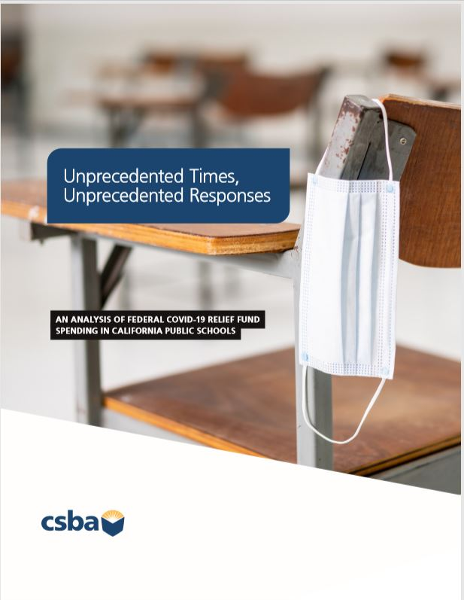
Unprecedented Times, Unprecedented Responses: An analysis of federal COVID-19 relief spending in California public schools
First of CSBA’s three-part series of reports on state and federal COVID-19 relief aid that includes:
First Report – An analysis of federal aid
Second Report – An analysis of state aid (coming soon)
Third Report – Findings from a CSBA survey of over 200 school district and county office of education superintendents and chief business officers (coming soon)

Slide 6
Guiding Questions
Is COVID relief funding being spent by recipient school districts and county offices of education (COEs)?
What can we learn about school district and COE spending in different categories from expenditure reports?
What implementation challenges are school districts and COEs facing?
What are the implications for CSBA’s advocacy efforts?

Slide 7
About CSBA’s COVID-19 Relief Funding Survey
Survey Focus Areas:
Spending priorities
Spending progress
Challenges in implementation and spending
AB 86’s paraprofessional requirement
Recommendations for changes to current and future relief aid

Slide 8
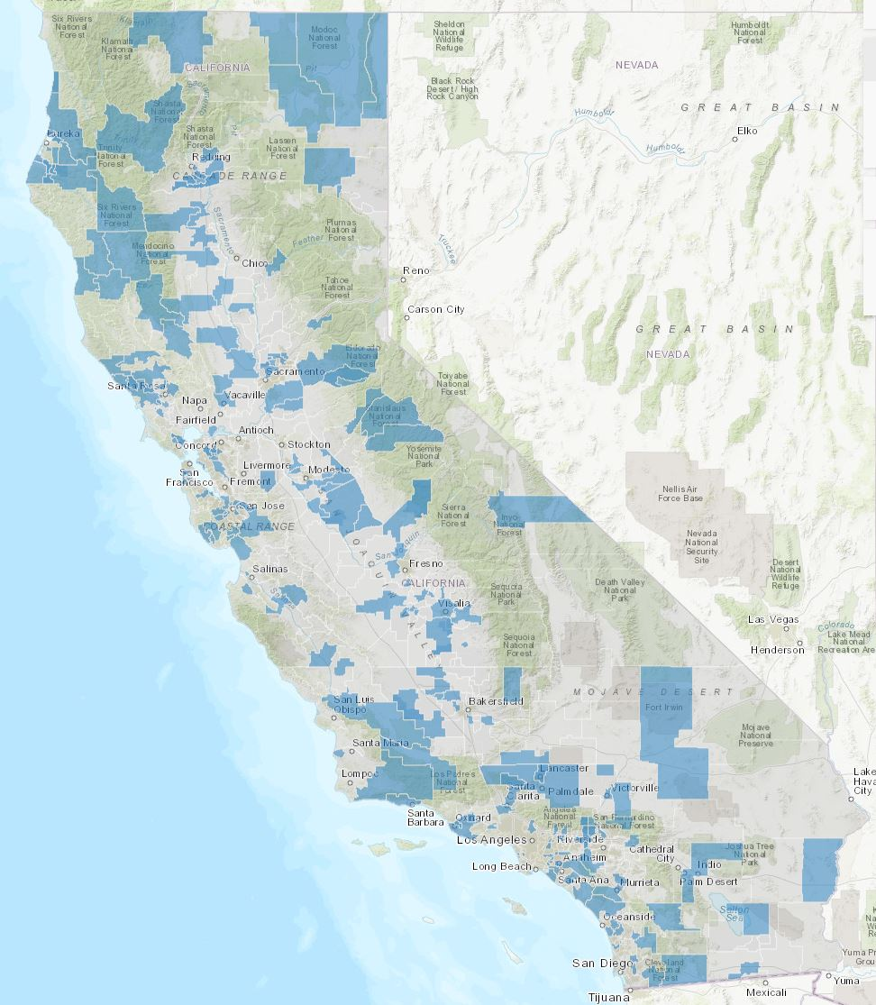
Survey Respondents
239 local educational agencies
229 school districts
10 county offices of education
Participating LEAs educate ~23% of CA students
Largely representative of statewide district type:
Elementary (51%)
Unified (36%)
High (8%)
50% rural, 35% suburban, and 15% urban
Notes:
Even though we had more rural respondents, urban districts represented larger districts (23 5000 and up, as opposed to rural 4 with 5000 and up)
Statewide district type → Elementary – 55%, Unified – 37%, High – 8%

Slide 9
Data sources for spending analysis
Publicly available quarterly expenditure reports for school districts and county offices of education
What is included in the data?
ESSER I and GEER I
7 reporting periods:
Fall 2020, Winter 2020, Spring 2021, Summer 2021, Fall 2021, Winter 2021, Spring 2022
ESSER II and IIII
4 reporting periods:
Summer 2021, Fall 2021, Winter 2021, Spring 2022
Notes:
In our guiding questions, we wanted to address issues related to how and if federal relief funding was being spent. To do that we pulled the publicly available quarterly expenditure reports for school districts and COEs.
What is included: Total amount the state allocates each reporting period for both county offices of education and school districts, the expended amount by reporting period, the previously expended amount, and the percent spent of the expended amount in the allowable categories
Since ESSER I and GEER I have been around for longer, they have more reporting periods than ESSERs II and III. Each of these packages have their own, individual deadlines to reserve and deadlines to spend funding that we will touch on shortly

Slide 10
What are the limits of what federal spending data can tell us?
These reports tell us what LEAs have spent, NOT what they have plans to spend.
Broader spending categories enable local decision making with funds but also make it difficult to discern more fine-grained expenses.
Fluctuating data:
LEAs that did not complete assurances or expenditure reports by specific deadlines show a $0 allocation for the following reporting period.
This means that the number of LEAs showing funding available had the potential to change each reporting period.
Substantial variance in the data:
LEAs had different needs in different times.
Notes:
While it is good to know what this data can tell us, it is important to acknowledge what it can not.
LEAs that did not complete assurances by 7/12/21 show a $0 allocation for 2021 Fall. Allocations for 2021 Winter reflect the LEA's eligibility amount to allow for reporting prior to the December 17, 2021, deadline to sign assurances. LEAs that did not sign assurances by this deadline will show a $0 allocation in future quarters.
There was substantial variance in the amount LEAs had spent AND what they were spending that funding on. We will touch on this again shortly, but because of the variance, our analysis of categories should be considered more as a modest indicator of trends in spending is happening than precise calculations
With what the data can tell us and its limits in mind we aimed to answer some of our guiding questions the first of which is…

Slide 11
Question 1: Are school districts and COEs spending down COVID relief funding?
Yes, on average California LEAs are spending down federal relief funding according to federal deadlines.
Notes:
LEAs are spending down the money, but there are mitigating factors and challenges surrounding spending that we will go in to.

Slide 12
Federal COVID-19 Relief Funding Packages
 | Total Amount to CA | Deadline to Reserve | Deadline to Spend
ESSER I | $1.6 billion | 9/30/2022 | 1/30/2023
GEER I | $355 million | 9/30/2022 | 1/30/2023
ESSER II | $6.7 billion | 9/30/2023 | 1/30/2024
ESSER III | $15.1 billion | 9/30/2024 | 1/30/2025*
Notes:
Let’s zoom out for a second, it is important to keep in mind a couple of things. First, each package comes with its own deadline to reserve money for expenditures and to actually spend the funding. These deadlines are important and according to our survey they are a factor in how districts and county offices plan their spending. Second, each subsequent aid package has been larger than the one before. That certainly has implications for how districts prioritize funding and how they choose what to spend the different packages on.
For ESSER III – I’m going to highlight the asterisk here. There have been some recent developments, recently the US Department of Education has stated that LEAs may apply to DOE for an 18 month extension to ESSER III funding. However, funds still need to be obligated by that September 2024 deadline. School construction projects are being prioritized for extensions.
So back to our question about if school districts and COEs are spending the funding we first looked at statewide averages…

Slide 13
Progress on Federal Spending Packages through
March 31, 2022
 | Current statewide average | LEAs that spent 40% or above
ESSER I | 94% | 98%
GEER I | 87% | 91%
ESSER II | 57% | 66%
ESSER III (Main) | 17% | 13%
ESSER III (Academic Impact) | 10% | 10%
Notes:
We see progress across all packages with greater percentages of funding spent in earlier packages.
We also looked at what percent of school districts and COEs spent 40% or more (I’ll explain why we picked that number) to see even more spent across most packages.
However, due to the broad range in spending we wanted to see, with more precision, how many SDs and COEs had spent how much more granularly

Slide 14
ESSER I – Spending by bands
Spending Bands | 2020 Fall | 2020 Winter | 2021 Spring | 2021 Summer | 2021 Fall | 2021 Winter | 2022 Spring
0-20% | 696 | 528 | 248 | 73 | 30 | 14 | 11
21-40% | 90 | 132 | 152 | 73 | 46 | 10 | 4
41-60% | 42 | 73 | 124 | 76 | 69 | 60 | 19
61-80% | 31 | 63 | 134 | 121 | 88 | 80 | 66
80-100% | 48 | 113 | 251 | 568 | 678 | 747 | 810
LEAs | 907 | 909 | 909 | 911 | 911 | 911 | 910
Count of LEAs
Spending Bands | 2020 Fall | 2020 Winter | 2021 Spring | 2021 Summer | 2021 Fall | 2021 Winter | 2022 Spring
0-20% | 76.7% | 58.1% | 27.3% | 8.0% | 3.3% | 1.5% | 1.2%
21-40% | 9.9% | 14.5% | 16.7% | 8.0% | 5.0% | 1.1% | 0.4%
41-60% | 4.6% | 8.0% | 13.6% | 8.3% | 7.6% | 6.6% | 2.1%
61-80% | 3.4% | 6.9% | 14.7% | 13.3% | 9.7% | 8.8% | 7.3%
80-100% | 5.3% | 12.4% | 27.6% | 62.3% | 74.4% | 82.0% | 89.0%
Percent of LEAs
Notes:
There’s a lot going on on this slide, but all it is showing is the number of LEAs that spent a certain percentage of their funding each quarter. For instance…Gold Boxes
We see a shift in spending more of the relief packages across time, which is what we would hope to see.
Additionally, 65% of the LEAs that received ESSER I funds have spent 100% of the funding
We see that shift in spending through time across all spending packages.
Next, in the report, we move to looking at how school districts and COEs are reporting on their usages of the funds

Slide 15
Question 2: What are school districts and COEs spending relief funding on?
The changing needs of the diverse range of CA LEAs during the pandemic are reflected in the data.
LEAs are coding a sizable portion their federal spending into broader ESSER categories.
Larger, increasing percentages of funding are being spent on addressing learning recovery in both ESSER II and even more so in ESSER III.
The rate of spending for later ESSER packages is slower than in earlier packages.
Notes:
What do I mean by these categories and more specifically “broader ESSER categories?” As I mentioned earlier, each package has a list of allowable uses for these funds. Some are more narrowly defined like purchasing cleaning supplies, or inspecting air quality. Some are broader like “activities necessary to maintain operations” or “ resources for schools”.
Districts were at different starting points at the beginning of the pandemic and as it went on…some districts had to immediately spend funding on virus mitigation equipment, while others had to shift to heavy expenditures in educational technology to facilitate distance learning. The point is that no one could foresee the wide range of needs that districts would go through over the past few years. As schools reopened, again they had substantially different needs for their students. Although it does not come without its challenges, the federal funding was designed with this in mind and was intended to provide flexibility for school districts and COEs to make decisions quickly to address rapidly changing situations. This is all reflected in the spending reports.
The rate of spending in later packages is slower than in earlier packages, which may be the result of a number of challenges that Mary will discuss. It is again, important to note, that these are substantially larger packages so those smaller percentages can equal much larger sums of money
We analyze all of the packages in the report, but just to exemplify some of main findings we highlight ESSER I where…

Slide 16
ESSER I - Average Percent Spent on Individual Categories
Notes:
Again, as we highlighted earlier, there is a lot of grey area surrounding what types of spending fall into each of these buckets which could also cause understandable confusion for sometimes complex, financially substantial programs where to code that spending.
Over time, LEAs reported spending in more general categories such as “other activities necessary to maintain operations” and “ resources for schools” which are more of a black box than other categories.
However, we can also see the changing needs of LEAs over the course of the pandemic. Such as a decline in the purchasing of cleaning supplies and the rise in expenditures of additional learning supports (in other packages).

Slide 17
GEER I - Average Percent Spent on Individual Categories
Notes:
In GEER I which was designed to be more targeted for those hardest hit by the pandemic we can see larger spending in devices/connectivity and PPE which when thinking through the needs of those most impacted makes sense.
As I mentioned, in our survey, we found real challenges that district leaders faced when spending and planning to spend these funds…

Slide 18
Challenges to Spending
Relief funding was essential for schools, but there are significant challenges:
Staffing levels (especially with one-time money) and staff burnout
Concerns about many programs and services not being sustainable due to the nature of one-time funding
Concerns about some infrastructure expenses extending past the deadlines
Supply chain issues
Slow permitting processes
Reporting burdens and confusion about guidelines including plan submissions

Slide 19
Question 3: Are there notable differences in how school districts and county offices are spending their relief aid?
Generally, COEs were more likely to report funding in the broader categories.
In Spring 2022, COEs nearly doubled the average percent of ESSER III funds they spent on expenses related to learning recovery making that their second largest category.
For GEER, county offices increased expenditures in professional development and learning supports in Spring 2022.
Notes:
County offices can serve very different needs for students and may require different spending priorities.
…broader categories, however, we do see changes over time in COEs that include a doubling of ESSER III funds in expenses related to learning recovery making that their second largest expense. And in GEER…
So with all of these findings in mind, what does this mean for board members….

Slide 20
Implications for Board Members
School board members will want to be aware of the federal spending deadlines (both to reserve and spend the funding) as they monitor the use of federal aid.
Governing boards may also want to consider the best ways to communicate with communities about their spending progress.
Governing boards will want to continue to engage with their communities to identify emerging needs and priorities with equity in mind.

Slide 21
How can school districts and county offices of education use COVID relief funding data to engage the public and build support for initiatives?
Be proactive about sharing the data.
Be as specific as possible about expenditures
Connect expenditures to goals cited in LCAP, strategic plan, community surveys, etc.
Preview future strategies & goals for funding
Talk honestly about the challenges you face
Promote your successes
Engage partners to help tell your story
Communicate a vision beyond the pandemic

Slide 22
Thank You!
For any questions, please contact: csba@csba.org
To read the full report: CSBA.org/COVID_spending_report

