Slide 1
Health Reform: Schools Connecting Families to Coverage
ALL IN Campaign
DATE
Presentation by:
The Children’s Partnership

Slide 2
Presenter
INSERT
PHOTO
Melissa Vargas
Campaign Manager, ALL IN
The Children’s Partnership
mvargas@childrenspartnership.org

Slide 4
What We Will Cover
ABC’s of the Affordable Care Act (ACA or Obamacare)
Covered California
Medi-Cal
How to Enroll
The ALL IN Campaign in Schools
Q & A

Slide 5
Why this Matters to Schools
Schools touch the lives of nearly every child and parent in California.
Health positively impacts learning and attendance.
YOU can connect children and families to newly available health care coverage that keeps kids healthier and ready to learn.

Slide 6
The Affordable Care Act
(ACA or Obamacare)
In March 2010, President Barack Obama signed comprehensive health reform, the Patient Protection and Affordable Care Act (ACA or Obamacare).
The ACA will bring historic opportunities to achieve health coverage for millions of children and families.
THIS is a DEFINING moment for anyone whose passion is education and healthy children and families.

Slide 7
Affordable Care Act
Offers
No one can be turned down for coverage
No denial for pre-existing conditions
Rates not based on health status
Comprehensive benefits
Choice of affordable plans

Slide 8
ACA
Essential Health Benefits
Ambulatory patient services
Emergency services
Hospitalization
Maternity and newborn care
Mental health and substance use disorder services, including behavioral health treatment
Prescription drugs
Rehabilitative and habilitative services and devices
Laboratory services
Preventive and wellness services and chronic disease management
Pediatric services, including dental and vision care

Slide 9
What is Covered California?
California’s new health insurance marketplace.
The first health exchange in the country formed under the ACA.
One of 17 state-based marketplaces.

Slide 10
Who Can Benefit from Covered California?
5.3 million California residents.
2.6 million may be able to get financial assistance through tax and cost-sharing subsidies.
    For example, a family of four that makes less than $94,200 a year but more than $32,500 a year may be eligible for financial assistance.
Legal residents currently without coverage through work or another government program.
Notes:
In SSF with over half of your students socioeconomically disadvantaged, there is great potential for improved health coverage.

Slide 11
Covered California
It’s Affordable
No annual limits
Premiums based on income
Copays that are not a deterrent to care
Zero deductible for many plans
Free preventive care
Lower out-of-pocket maximums
Notes:
In SSF with over half of your students socioeconomically disadvantaged, there is great potential for improved health coverage.

Slide 12
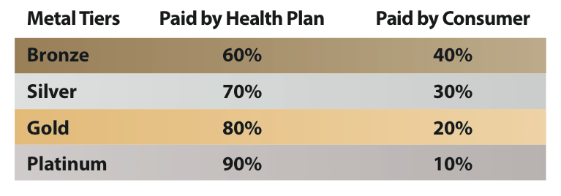
Health Insurance Plan Tiers
Notes:
In SSF with over half of your students socioeconomically disadvantaged, there is great potential for improved health coverage.

Slide 13
What is Medi-Cal?
Medi-Cal is California’s Medicaid program that provides health coverage to low- to moderate-income children and adults who do not qualify for subsidies through Covered California.
8.5 million people currently enrolled, including half of all children in California.

Slide 14
Who Can Benefit from Medi-Cal?
2.4 million adults may become newly eligible for Medi-Cal.
    If annual income for a single adult is less than $15,856, adults (including those without children) may be eligible for Medi-Cal.
    If annual income for a family of two is less than $21,400, adults (including those without children) may be eligible for Medi-Cal.
Nearly 500,000 children who are not currently enrolled in Medi-Cal, will likely be eligible.
    If annual income for a family of four is less than $58,875, children may qualify for Medi-Cal.
Under the current program, recipients of the Deferred Action for Childhood Arrivals (DACA) process, 21 years of age or younger.

Slide 15
Families of Mixed Immigration Status
Undocumented immigrants make up 7 percent of California’s population.
Nearly 3 million individuals will remain uninsured on January 2014.
Many programs or services throughout the state that offer coverage for children, regardless of their immigration or residency status.
    Children’s Health Initiatives
    Healthy Kids
    Kaiser Permanente Child Health Plan
    Clinics
    Emergency Medi-Cal

Slide 16
Helping Consumers Enroll
http://bit.ly/17CVjRe
Notes:
In SSF with over half of your students socioeconomically disadvantaged, there is great potential for improved health coverage.

Slide 17



Helping Consumers Enroll
Notes:
In SSF with over half of your students socioeconomically disadvantaged, there is great potential for improved health coverage.

Slide 18
Enroll Now
Open Enrollment for Covered California: October 1, 2013 – March 31, 2014
Medi-Cal:
    Children – anytime
    Adults – started October 1, 2013
Coverage for Covered California and Medi-Cal for newly eligible adults started January 2014
Notes:
In SSF with over half of your students socioeconomically disadvantaged, there is great potential for improved health coverage.

Slide 19
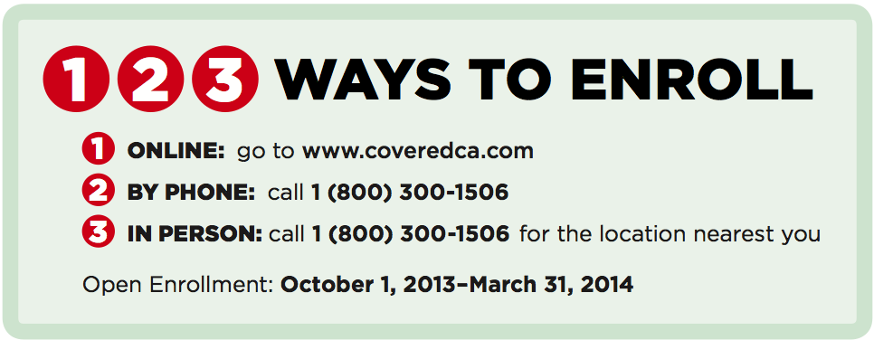
How to Enroll in Covered California
Notes:
In SSF with over half of your students socioeconomically disadvantaged, there is great potential for improved health coverage.

Slide 20

www.coveredca.com
Shop & Compare Tool – helps you find insurance plans, and if you qualify for financial assistance or Medi-Cal.
Find Help Near You – allows you to search for a CEC, agent, or county office by zip code or name.
Notes:
In SSF with over half of your students socioeconomically disadvantaged, there is great potential for improved health coverage.

Slide 21

ALL IN is a statewide Campaign to inform millions of people in the school community about health coverage options now available through Covered California, and help them enroll.

Slide 22
ALL IN Aims to Cover
Children
Parents
School Employees
Early Learning & After-School Staff

Slide 23

Our Anchor Partners

Slide 24
Why Schools Should Care
Healthy children attend class more often and learn better!
Families trust information they receive from schools.
Schools are uniquely positioned to serve as “on-ramps” to connect uninsured children, parents, and staff to coverage.
Schools have the ability to reach and help millions of children and families get affordable health coverage – if they make the move to get ALL IN.

Slide 25


The Potential is Great!
Over 10,000 schools across California.
Approximately 4,500 after-school programs across California.
Over 11,000 licensed child-care centers across California (including Head Start sites).
Nearly 33,200 licensed child-care providers across California.

Slide 26

Campaign Elements
Website www.allinforhealth.org
English and Spanish Language Materials
Resources and Links
Social Media
Enrollment Events

Slide 27

ALL IN Toolkit Includes
Fact Sheet
School Leaders
Parents & Families
Early Learning Leaders
After-School Leaders
Game Plan
School Leaders
Wallet Card
Enrollment Tip Sheet

Slide 28
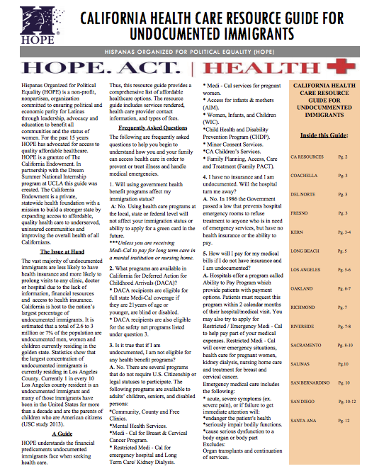
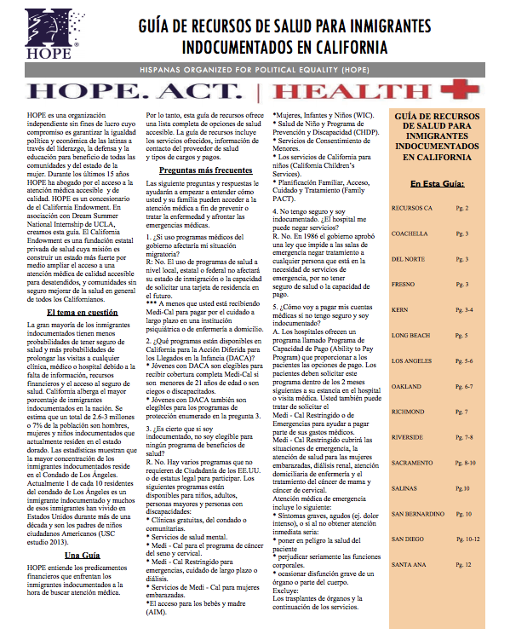
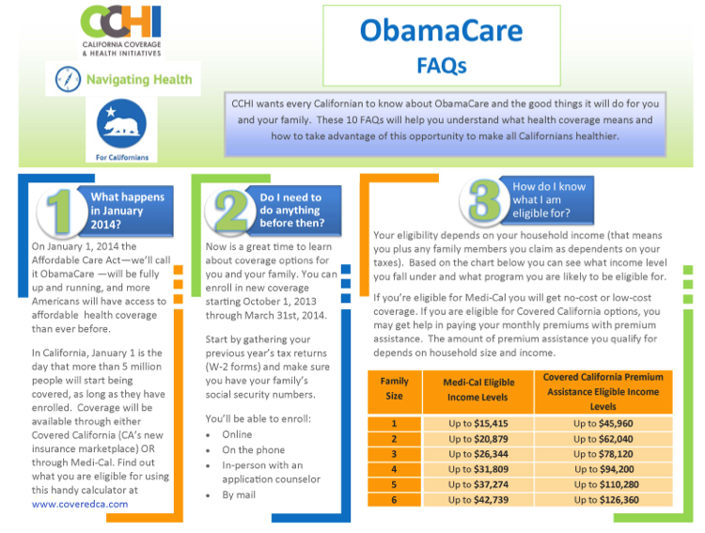
Third Party Resources & Links
CCHI’s 10 FAQ about Obamacare
Hispanas Organized for Political Equality (HOPE) resource guide for undocumented immigrants
Link to Covered California’s FAQ
Link to FAQ for Medi-Cal eligibility

Slide 29
How YOU Can Help
Get informed. Provide leadership and help the cause.
    Learn more about the ACA by visiting www.coveredca.com.
    Visit www.allinforhealth.org to download an ALL IN toolkit.
Share ACA Information.
    Distribute ALL IN materials to your school or district.
    Highlight information and materials in school announcements, newsletters, e-mail blasts, website, blog, and social media.
    Send information directly to families and employees via text, robocalls, or simply in a backpack letter.

Slide 30
How YOU Can Help
Create an environment for success.
  Provide health coverage information at school events, including parent meetings, sporting events, and other school related activities.
  Organize an informational training webinar with ALL IN, so you and your staff know the ACA basics and available health care programs.
  Host an education and enrollment event! ALL IN can help connect you to on-site enrollment assistance.
  Identify interest among your staff in becoming Certified Enrollment Counselors (CEC) or becoming a Certified Enrollment Entity (CEE).
  Adopt a resolution at your school district to ensure enrollment nights are organized with help of ALL IN staff.

Slide 31
CEEs and CECs
Certified Enrollment Entity (CEE)
    An entity registered by Covered California to provide one-on-one consumer assistance.
    Responsible for entering into a contract with Covered California, having CEC affiliate with them, and oversee CECs.
Certified Enrollment Counselor (CEC)
    An individual certified by Covered California to provide face-to-face, one-on-one consumer assistance.
    School and early learning staff can become a CEC by completing the required training provided by Covered California.
    Responsible for providing education, eligibility, enrollment, and retention.

Slide 32
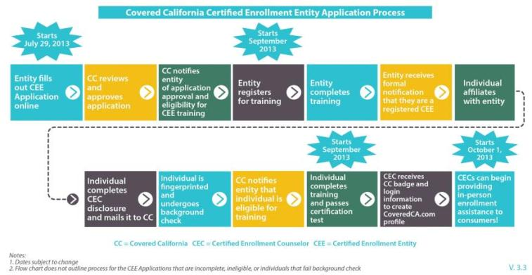
Online Application Process
for a CEE & CEC

Slide 33
Questions on CEEs or CECs
        For more information, contact the Covered California Enrollment Assistance Program Help Desk available Monday through Friday, from 8:00 am to 5:00 pm at:
        1 (888) 402-0737
        https://assisters.ccgrantsandassisters.org
        assisterinfo@ccgrantsandassisters.org

Slide 34
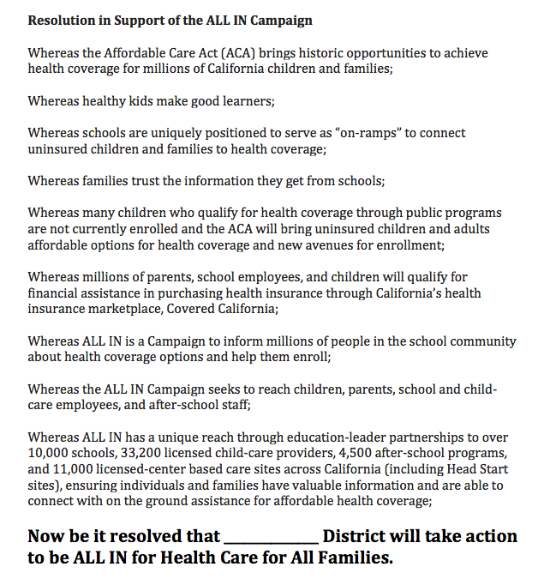
Sample Resolution

Slide 35
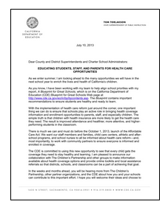
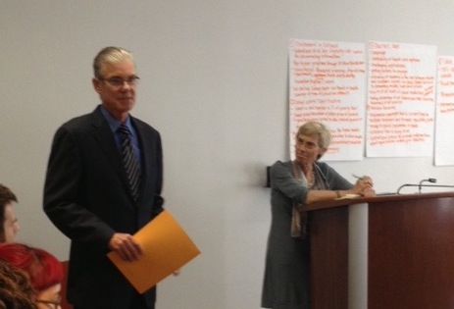
Superintendent Tom Torlakson is ALL IN!
“Schools can play an active role in bringing ACA health coverage information and enrollment opportunities to parents, staff, and especially children.”

Slide 36


California State PTA is ALL IN!
Direct Action:
Emailed newsletter with ALL IN information to 10,000 local PTA leaders and/or parents.
Placed ALL IN badge with link on website and Facebook.
Provided 120-member state board information and materials.
Sent 70,000 emails to principals and superintendents via PTA Connects.

Slide 37
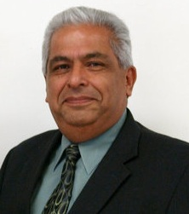

Moreno Valley Unified School District is ALL IN!
Direct Action:
Trained staff on new regulations.
Provided links on website of local resources, like the ALL IN Campaign.
Promoting resolutions within school districts to ensure enrollment nights are organized with help of ALL IN staff.
Jesus Holguin,
Vice President, California School Boards Association

Slide 38
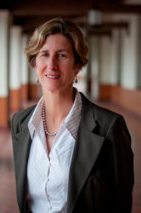

First 5 LA is ALL IN!
Direct Action:
Posted ALL IN materials on website.
Introduced ALL IN to partners and colleagues.
Will use ALL IN to sponsor enrollment nights at schools or child-care.
Kim Belshé,
Executive Director, First 5 LA;
Member, California Health Benefit Exchange Board

Slide 39
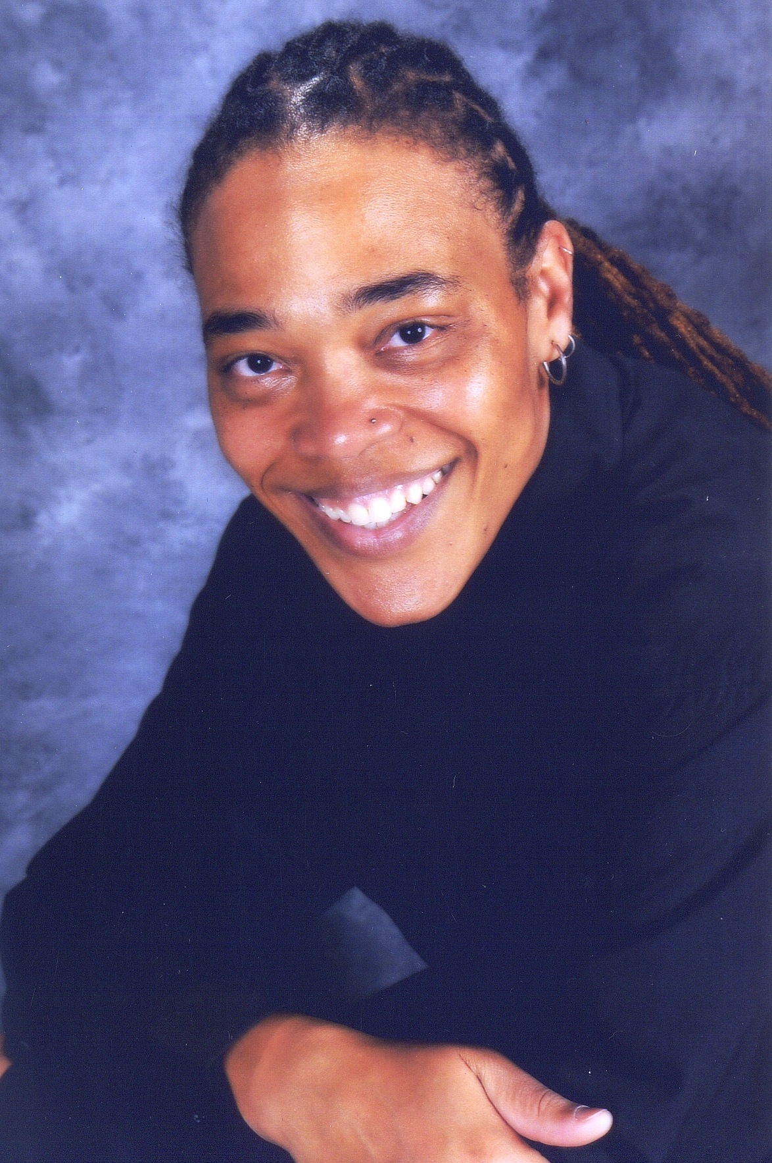

Sacramento City Unified School District is ALL IN!
Direct Action:
Ensuring all staff have accurate and consistent information.
Working with students and parents to share materials.
“Sac City is using its existing infrastructure but is excited about using ALL IN materials to help share the information about affordable health insurance”.
      Nichole Wofford,
      Specialist, Integrated Support Services,
      Sacramento City Unified School District

Slide 40

Student Organizers in San Juan Unified School District are ALL IN!
Phase I – Outreach & Education
Team of 16 student organizers will provide 22 schools in San Juan USD ALL IN informational materials.
Student organizers will reach out to three schools each week between Nov. 4th and Dec. 20th.
Student organizers will invite school staff, students, and families to Enrollment Fair in January.
Phase II – Enrollment
Host Back-to-School ACA Enrollment Fair on January 11th.
Work closely with ALL IN staff to provide on-the-ground assistance.

Slide 41
Partial List of Outreach Partners
Association of California School Administrators
California Association of African-American Superintendents and Administrators (CAAASA)
California Child Care Resource & Referral Network
California Family Resource Centers Association
California Head Start Association

Slide 42
Additional Outreach Partners
California Network of Family Strengthening Networks
California School Employees Association
California State PTA
First 5 Association
Los Angeles Unified School District

Slide 43
The Difference YOU Can Make
Schools touch the lives of nearly every child and parent in California.
YOU have the power to connect children and families to the health care coverage they need and deserve.

Slide 44
Contact
www.allinforhealth.org
allinforhealth@
childrenspartnership.org
(916) 844-2413
Presenter:
Melissa Vargas mvargas@childrenspartnership.org

