Slide 1
The CSBA County Board Handbook: Advocacy and Community Engagement

Slide 2

Housekeeping
Please use the Q&A feature to submit your questions. This is located on the ribbon below the speaker. The chat feature has been turned off.
Your questions will be answered either in the Q&A feature in writing or live by our presenters
All attendees will receive a link to this video recording as well as resources in a follow up email after the webinar.

Slide 3
Panelists:
Patrick O’Donnell, CSBA Chief, Governmental Relations
Chris Reefe, CSBA Legislative Director
Annette Lewis, CSBA Region 14 Director, Board member Contra Costa COE
Dr. Ramon Flores, CSBA Director-at-Large, County, Board member Ventura COE
Moderator:
Mike Walsh, CSBA Director, County Board Services

Slide 4
Vision
The California School Boards Association is the essential voice for public education. We inspire our members to be knowledgeable leaders, extraordinary governance practitioners and ardent advocates for all students.
Adopted January 2016.
Mission
CSBA strengthens and promotes school board governance. We define and drive the public education policy agenda through advocacy, training, and member services. Strong local boards of education are essential to ensure a high-quality education for every student in every community.
Adopted December 2015.

Slide 5
“External Advocacy”
Influencing policy, legislation, and funding.
“Representative Advocacy”
Ensuring community voices, especially those least heard, are reflected in governance decisions.

Slide 6

Closure – the quality of member relations within the board.
Brokerage – board member influence on outside stakeholders and those with influence.
School Board Capital
Notes:
Page 11 in the Handbook

Slide 7
Limited closure warnings
Limited closure leads to individuals acting for their own interests rather than the good of the entire organization.
Ongoing power struggles
Missed opportunities
Loss of influence in the community
Focus on a specific interest group only
The cure
Team building that focuses on developing trust, collaboration, and articulating a shared vision

Slide 8
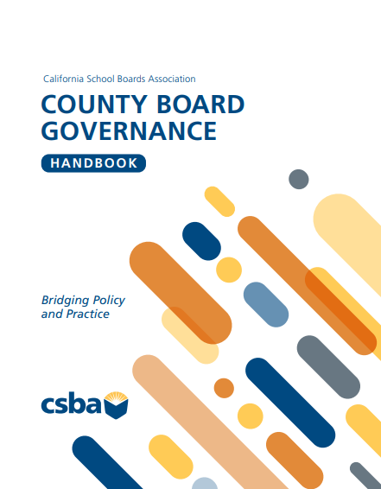

Slide 9
Q&A

Slide 10
Upcoming Events:
County MIG
Aug 14-15,Yolo COE
Sep 24 - Marina Del Rey Marriott
Counties Conference
Sep 25-27, 2026
Marina Del Rey Marriott
  Damon West – Speaker, college professor and author of The Coffee Bean
  Alex Ballantyne and Director Shaun Kadlec “Possible Selves” Documentary
AEC
Workshop
Conference

