Slide 1
Stand up for education
State of the (Name of district)
School district update
(Name of Board president), President, Board of Education
(Name of Superintendent), Ed.D., Superintendent

Slide 2
Presentation overview
2
PAGE
Facts about the district
School Funding Crisis
Highlight of successes and stellar programs
Looking ahead
Stand Up For Education

Slide 3
About your school district
3
PAGE
(Customize this section giving your audiences details about the district and your schools)
Size and scope
Number of California Distinguished Schools & Blue Ribbon Schools
Student demographics
Governance (size of elected board, etc.)

Slide 4
How are public schools funded?
4
PAGE
The State Provides the Majority of K-12 revenues
56% State
21% Local property taxes
14% Federal
1% State lottery
8% Other (categorical)
Source: California Department of Education. The state’s contribution slightly fluctuates each year. Over the past decade, the state’s contribution has averaged 55%.

Slide 5
School Funding Crisis
5
PAGE
Statewide overview
Worst ever in state’s history
$20 billion cut since 2008
Loss of 40,000 educators since 2008
Sources: California School Boards Association, Education Coalition, and California Department of Education.

Slide 6
Grim statistics—Sobering facts
6
PAGE
Source: National center for Education Statistics

Slide 7
More statewide facts
7
PAGE
74% of the districts statewide report increases in class sizes.
In grades K-3, class sizes statewide have swelled to 30+. These are key learning years for math and reading. Small classes sizes of 20:1 improve student learning and academic progress.
12 districts in the state have fewer than 180 instructional days.
46% of school districts statewide report cutbacks to campus security and adults on campus have impacted student safety on campus.
Source: EdSource “Schools Under Pressure: Pressures Mount on California’s Largest School Districts,” May 2012

Slide 8
California’s disinvestment in Public Education Hurts Students
8
PAGE
Low per-student funding levels = reduced programs and services for students
Fewer principals and teachers per student = higher safety risk with fewer staff supervising more students
Fewer teachers per student = larger class sizes
Fewer teachers per student = less individualized attention in key subject areas
Fewer teachers per student = reduced support for struggling students

Slide 9
Local funding picture
9
PAGE
Operating budget of ____________
Budget reductions since 2008 of ________________
Loss of _________ teaching positions
Loss of _______________ (list) student programs and services

Slide 10
Schools cannot sustain more cuts
10
PAGE
Without new revenue, schools statewide will be cut by another $457 per student, roughly a $5.5 billion in the 2012-13 school year
Locally, this translates into the loss of another ____________in revenue this school year
Students lose

Slide 11
Stand Up For Education
11
PAGE
Prop. 30 & Prop. 38 provide billions of dollars for schools
Board resolution to support both
Before making a decision at the ballot box, do your homework

Slide 12
Stellar local schools
12
PAGE
(customize with a listing of your star programs and quickly cite evidence of the success of your students)

Slide 13
Are students succeeding? Yes!
13
PAGE
(include relevant stats)

Slide 14
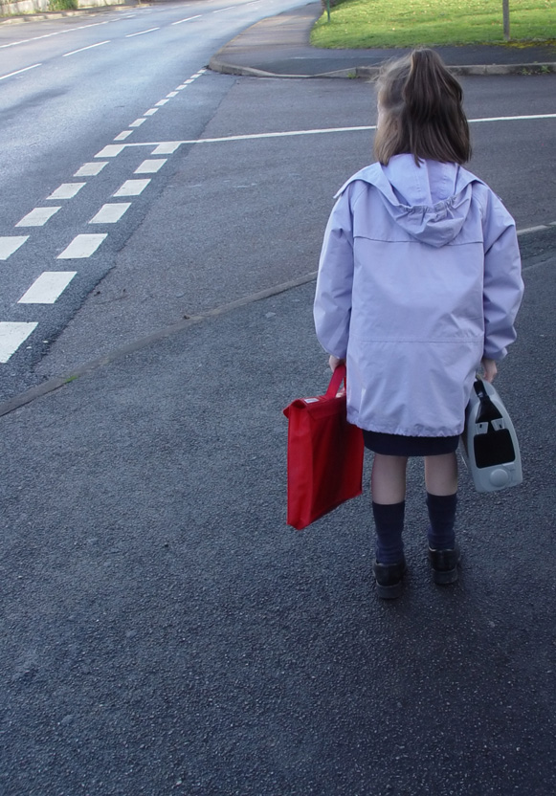
Looking ahead
14
PAGE
(tout good news)
(invite the audience to key school /district events)

Slide 15
Stand up for education
15
PAGE
These are your schools – support public education, get involved and volunteer.
Educate yourself with the facts about student achievement and success.
(customize with your own call to action – such as sign up for our eNewsletter, visit our website at www.xxx.edu, etc.)

Slide 16
Questions?
Contact

